Slide 1






Finding a new home in Staffordshire 1

Slide 2
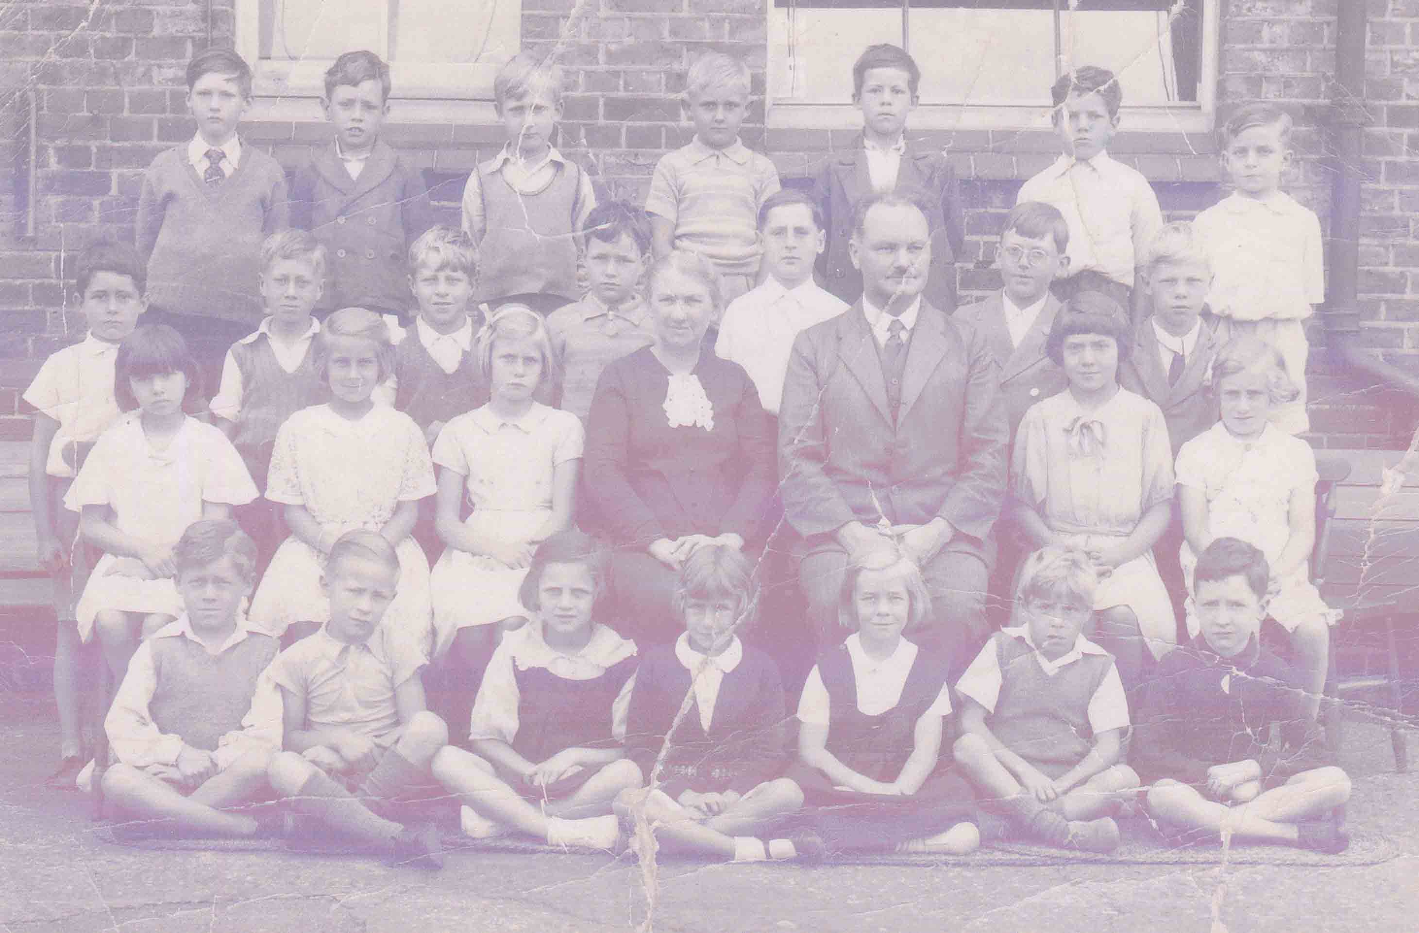
Teachers went with evacuees
Schools made lists of children to be evacuated
Local councils organised trains
Evacuation was organised by the government
Notes:
The evacuation scheme was organised by the British government. But evacuation itself was run by local councils and schools. Local councils organised trains to transport the children to safety and schools made lists of which children were to be evacuated and which teachers would go them.
When the time came to be evacuated, many children met at their school and travelled with their classes and their teacher to safe areas. They took a suitcase or bag filled with some clothes, their gas masks and also wore a label which had their name and other details on.

Slide 3
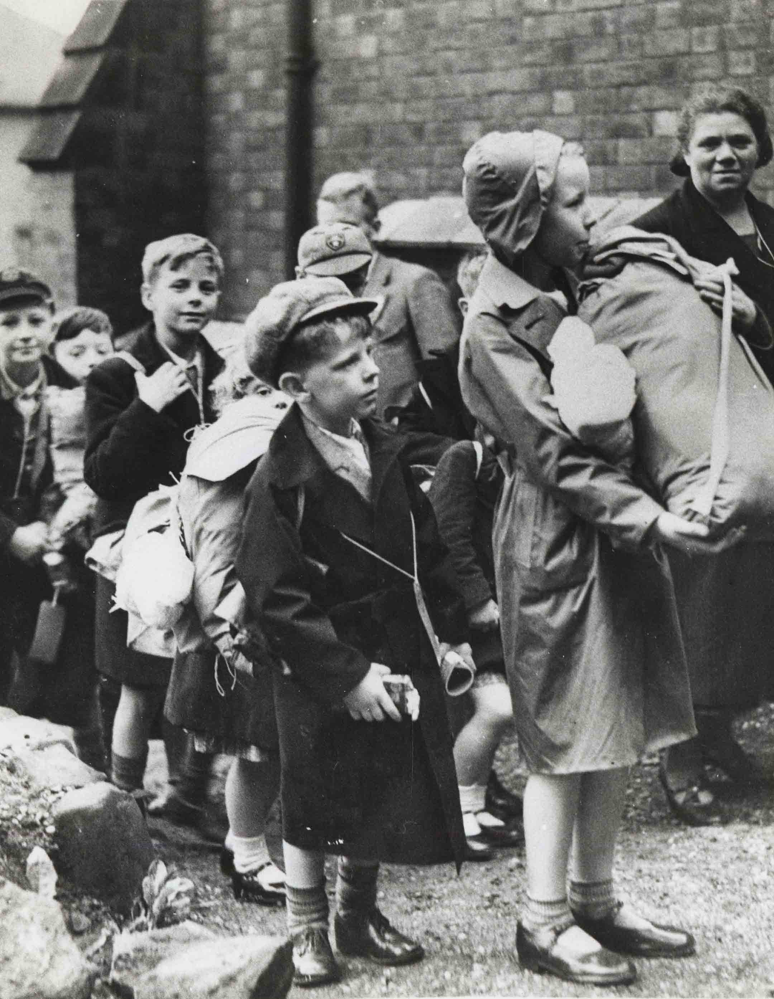
Evacuee’s were given homes with local families
These were called BILLETS
Notes:
Thousands of children travelled all day to get to Staffordshire. They did not know where they were going nor when then might be going home again. Many felt frightened and the long journey made them tired and hungry.
When they reached Staffordshire, they were met by a billeting officer. Their job was to find a billet or foster home for each child.

Slide 4
Finding a new home for evacuees
Read Source 3 from the local newspaper, the Staffordshire Advertiser.
Now answer these questions:
SOURCE 3
How were evacuees received by local people in Rocester?
Did all evacuees find homes?
Notes:
Source 3 shows:
Small children were sometimes evacuated with their mothers (under 5s)
Evacuees were made very welcome and local Staffordshire people tried to make them happy and comfortable
All evacuees could be found a home. There was more than enough homes and families willing to take them
Evacuation was well organised in Rocester, near Uttoxeter

Slide 5

Now listen to the memories of Basil Turner…
What does Basil say about the billeting process?
Basil was 18 and a Scout Leader when he was asked to help with the billeting of evacuees in Leek
How does Basil’s experience in Leek compare with Source 3?
Why are their accounts different?
Notes:
Billeting Officer’s often had a very difficult job:
They had to find homes for evacuees
They did not always know how many evacuees would be coming
They often did not know when they would arrive
Local newspapers can sometimes be biased. During the Second World War, newspapers probably tried to boost the morale of local people by reporting positive things about evacuation and the war. This could account for why Basil’s memories of the billeting process in Staffordshire was different from that given in source 3. In addition, the newspaper reports on billeting in Rocester whereas Basil talks about billeting in Leek. The reception and billeting of evacuees could have regional variations – there were no problems in Rocester, but not everyone was as enthusiastic in Leek.

Slide 6
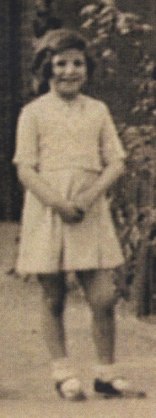
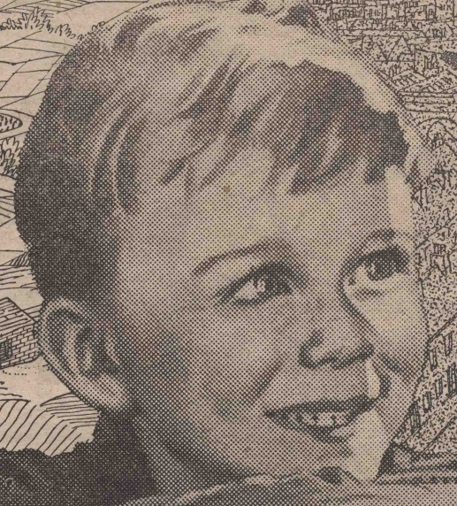
Now listen to these two evacuees talking about their experiences of finding a billet:
John
“…they were picking us out like you’d pick a prize pig…”
Dorothy
Notes:
Another evacuee, Betty Rose says “they were picking us out like you’d pick a prize pig”. What do you think she means?
What do these oral histories tell you about the billeting process?
Was finding homes for evacuees easy?
How did they do it?
How do they compare to the impression given by the newspapers?
How did the billeting process make evacuees feel?
How does it make a person feel if they do not feel wanted?
How does the billeting officer’s experience compare to that of the evacuees?
Dorothy Jarvis was evacuated from Longsight, Manchester to Alton, Staffordshire at the age of 9.
John Doughty was evacuated from Margate in Kent to Gentleshaw in Staffordshire. He lived in several billets during his evacuation.
Betty Rose was evacuated twice. She moved from her home in Essex to Norfolk in 1939 and then in 1940, aged 13, was sent to live in Wilnecote near Tamworth.

